Slide 1
Java oops concept and file handling
Presented by:
Kethe Shashank

Slide 2
What is oops
Software Development Technique
Used to improve code readability and reusability
Oops refers to languages that use objects in programming
Aims to implement real world entities.
Effective use of programmer productivity

Slide 3
Basic concepts of oops
Object
Class
Inheritance
Polymorphism
Encapsulation
Data Abstraction

Slide 4
Object
Java object is a member also called an instance of a class
Each object has an identity represented as, state and behaviour
State of an object stored in fields(variables)
Methods displays the object behaviour

Slide 5
Class
Logical template to create objects
All objects in a class share common properties and methods
Example: In real world a specific person is the object of Humans class

Slide 6
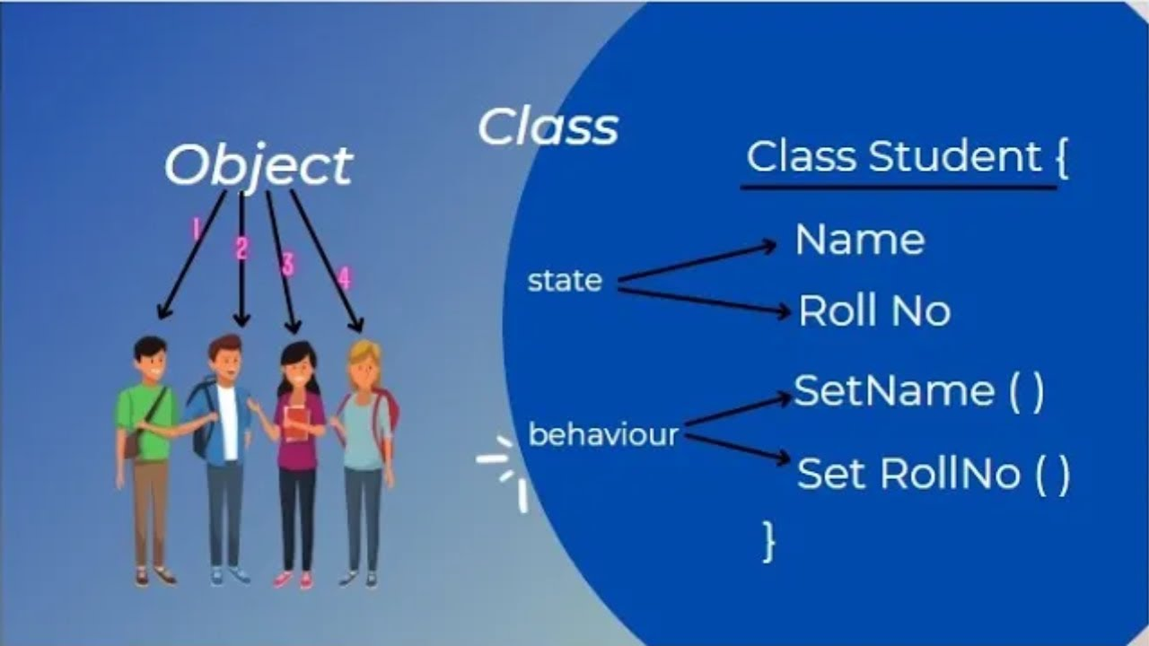
Example

Slide 7
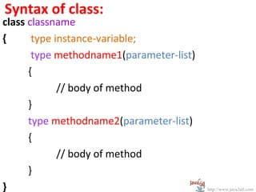
Syntax:

Slide 8
Inheritance
One object acquires all the properties and behaviors of a parent object
We can create new classes that are built upon existing classes.
Inheritance represent the IS-A relationship which is also known as parent –child relationship
Code reusability

Slide 9
Terms used in inheritance
class
Subclass/child class : subclass is a class which inherits the other class
Superclass/ Parent class : superclass is a class from where a subclass inherits the features

Slide 10
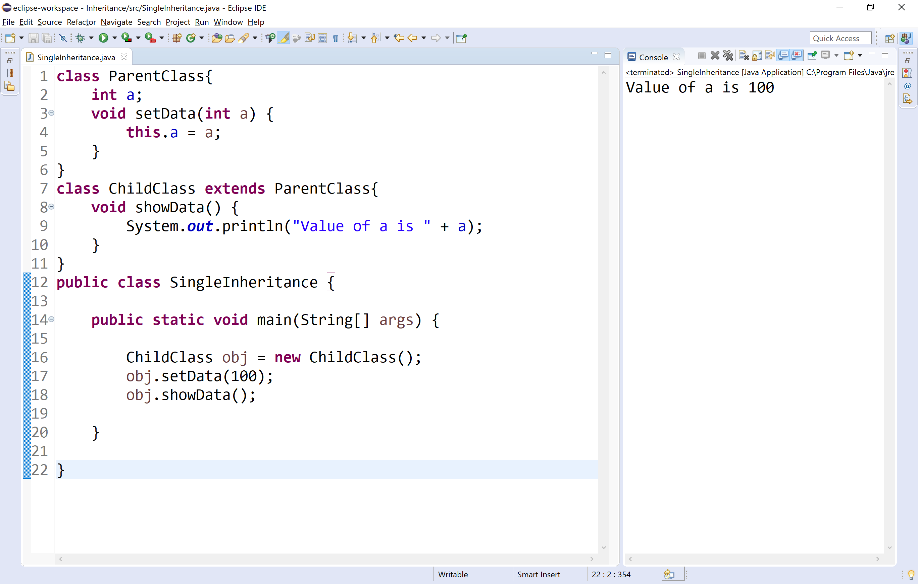
Example

Slide 11
Types of inheritance
Single inheritance
Multilevel inheritance
Hierarchical inheritance
Multiple inheritance
Hybrid inheritance

Slide 12
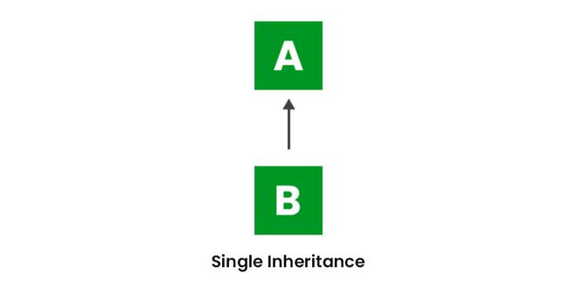
Single inheritance
When a class inherits another class

Slide 13
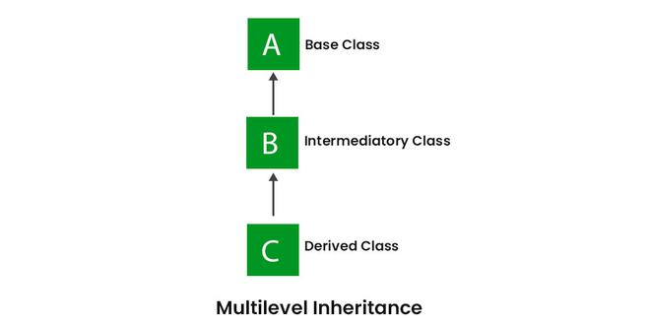
Multilevel inheritance
When a class inherits from a class and then another class inherits from that derived class

Slide 14
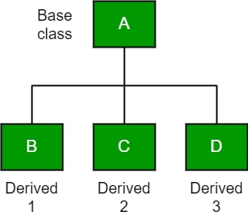
Hierarchical inheritance
Number of classes are derived from a single base class

Slide 15
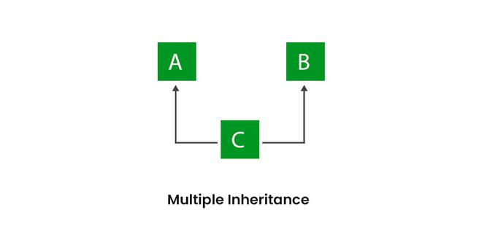
Multiple inheritance
Java does not support multiple inheritance due to ambiguity.

Slide 16
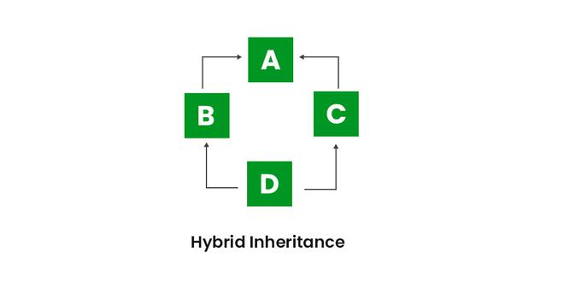
Hybrid inheritance
Hybrid means consists of more than one. Hybrid inheritance is the combination of two or more inheritance types

Slide 17
Polymorphism
The ability to take more than one form
Allows us to write generic, reusable code more easily
In java polymorphism is divided into two types
Compile time polymorphism
Run time polymorphism

Slide 18
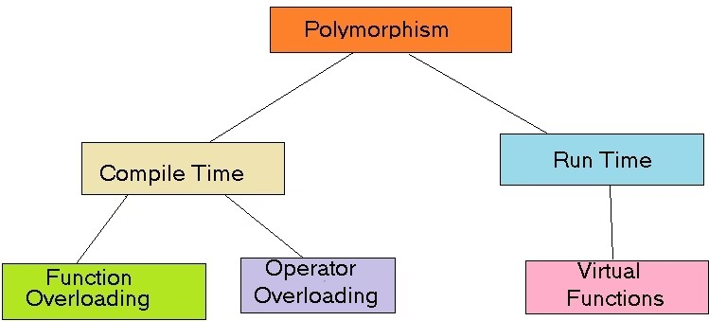

Slide 19
Encapsulation
Bundling of fields and methods inside single class
It prevents outer class from accessing and changing fields and methods of a class
It also helps to achieve data hiding

Slide 20
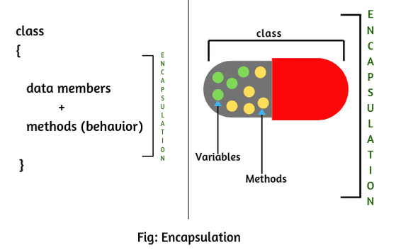
Example

Slide 21
Data abstraction
Hiding the implementation details from the user and showing only the functionality to the user
It can be achieved by using abstract classes, methods and interfaces
An abstract class is a class that cannot be instantiated on its own and is meant to be inherited by concrete classes.

Slide 22
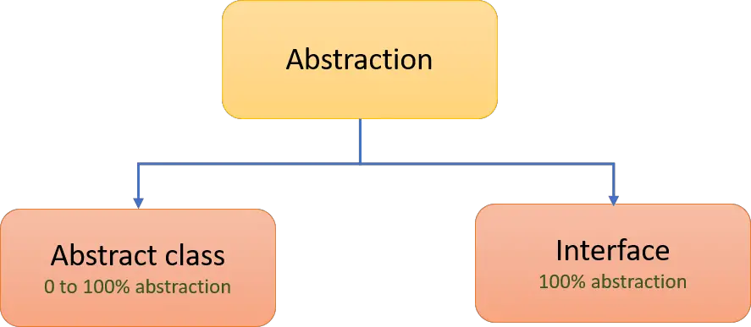

Slide 23
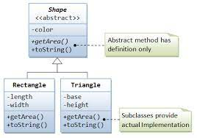
Example

Slide 24
Java file handling
In Java, with the help of File Class, we can work with files.
This File Class is inside the java.io package.
The File class can be used by creating an object of the class and then specifying the name of the file.

Slide 25
Why file handling is required?
File Handling is an integral part of any programming language as file handling enables us to store the output of any particular program in a file and allows us to perform certain operations on it.
In simple words, file handling means reading and writing data to a file.

Slide 26
Example code
// Importing File Class
import java.io.File;
class GFG {
public static void main(String[] args)
{
// File name specified
File obj = new File("myfile.txt");
System.out.println("File Created!");
}
}

Slide 27
Streams in java
In Java, a sequence of data is known as a stream.
This concept is used to perform I/O operations on a file.
There are two types of streams :

Slide 28
1. Input stream:
The Java InputStream class is the superclass of all input streams. The input stream is used to read data from numerous input devices like the keyboard, network, etc.
There are several subclasses of the InputStream class, which are as follows:
AudioInputStream
ByteArrayInputStream
FileInputStream
FilterInputStream
StringBufferInputStream
ObjectInputStream

Slide 29
syntax
Creating an InputStream
// Creating an InputStream InputStream obj = new FileInputStream();
Note: We can create an input stream from other subclasses as well as InputStream.

Slide 30
2. Output stream:
The output stream is used to write data to numerous output devices like the monitor, file, etc.
There are several subclasses of the OutputStream class which are as follows:
ByteArrayOutputStream
FileOutputStream
StringBufferOutputStream
ObjectOutputStream
DataOutputStream
PrintStream

Slide 31
Syntax
Creating an OutputStream
OutputStream obj = new FileOutputStream();
Note: We can create an output stream from other subclasses as well as OutputStream.
//

Slide 32
File operations
Create a File
Read from a File
Write to a File
Delete a File

